Slide 1
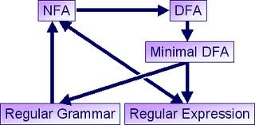
Regular Expressions
Course Instructor: Hashim Ayub

Slide 2

Regular Expressions
Regular expressions
describe regular languages
Example:
describes the language
$$(a+b⋅c)∗$$
$$\left\{a,bc\right\}∗=\left\{λ,a,bc,aa,abc,bca,...\right\}$$
Next, we see how this language is created

Slide 3
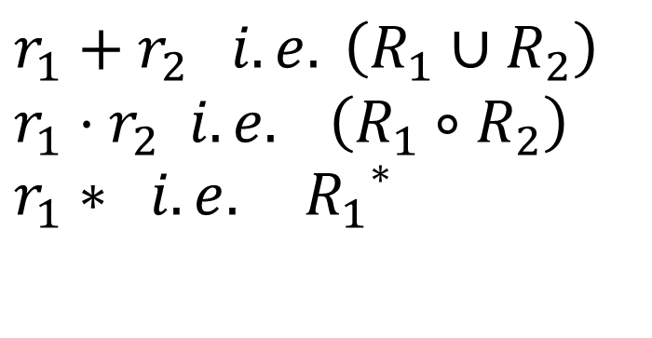



Recursive Definition
Primitive regular expressions:
$$∅, λ, α$$
for some α in alphabet Σ
$$r_{1}$$
Given regular expressions and
$$r_{2}$$
$$r_{1}+r_{2} i.e. \left(R_{1}∪R_{2}\right) \\ r_{1}⋅r_{2} i.e. \left(R_{1}∘R_{2}\right) \\ r_{1}∗ i.e.{{ R}_{1}}^{∗}$$
Are regular expressions

Slide 4

Examples
A regular expression:
$$\left(a+b⋅c\right)∗⋅(c+∅)$$

Slide 5


Languages of Regular Expressions
: language of regular expression
Example
$$L\left(r\right)$$
$$r$$
$$L\left((a+b⋅c)∗\right)=\left\{λ,a,bc,aa,abc,bca,...\right\}$$

Slide 6

Definition
For primitive regular expressions:
$$L\left(∅\right)=∅$$ $$L\left(λ\right)=\left\{λ\right\}$$ $$L\left(a\right)=\left\{a\right\}$$

Slide 7






Definition (continued)
For regular expressions and
$$r_{1}$$
$$r_{2}$$
$$L\left(r_{1}+r_{2}\right)=L\left(r_{1}\right)∪L\left(r_{2}\right)$$
$$L\left(r_{1}⋅r_{2}\right)=L\left(r_{1}\right) L\left(r_{2}\right)$$
$$L\left(r_{1}∗\right)=\left(L\left(r_{1}\right)\right)∗$$
$$L\left(\left(r_{1}\right)\right)=L\left(r_{1}\right)$$

Slide 8







Example
Regular expression:
$$\left(a+b\right)⋅a∗$$
$$L\left(\left(a+b\right)⋅a∗\right)$$
$$=L\left(\left(a+b\right)\right) L\left(a∗\right)$$
$$=L\left(a+b\right) L\left(a∗\right)$$
$$=\left(L\left(a\right)∪L\left(b\right)\right) \left(L\left(a\right)\right)∗$$
$$=\left(\left\{a\right\}∪\left\{b\right\}\right) \left(\left\{a\right\}\right)∗$$
$$=\left\{a,b\right\} \left\{λ,a,aa,aaa,...\right\}$$
$$=\left\{a,aa,aaa,...,b,ba,baa,...\right\}$$

Slide 9

Example
Regular expression
$$r=\left(a+b\right)∗\left(a+bb\right)$$
$$L\left(r\right)=\left\{a,bb,aa,abb,ba,bbb,...\right\}$$

Slide 10
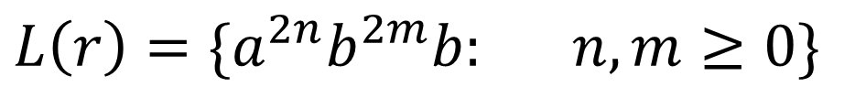

Example
Regular expression
$$r=\left(aa\right)∗\left(bb\right)∗b$$
$$L\left(r\right)=\{a^{2n}b^{2m}b: n,m≥0\}$$

Slide 11


Example
Regular expression
$$r=(0+1)∗00 (0+1)∗$$
$$L(r)$$
= { all strings containing substring 00 }

Slide 12

Example
Regular expression
$$r=(1+01)∗(0+λ)$$
$$L(r)$$
= { all strings without substring 00 }
How?

Slide 13


Equivalent Regular Expressions
Definition:
Regular expressions and
are equivalent if
$$r_{1}$$
$$r_{2}$$
$$L(r_{1})=L(r_{2})$$

Slide 14





Example
$$L$$
= { all strings without substring 00 }
$$r_{1}=(1+01)∗(0+λ)$$
$$r_{2}=(1∗011∗)∗(0+λ)+1∗(0+λ)$$
$$r_{1}$$
and
$$r_{2}$$
$$L(r_{1})=L(r_{2})=L$$
are equivalent
regular expressions

Slide 15
Regular Expressions and Regular Languages

Slide 16







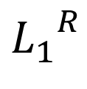
For regular languages and
RECAP
$$L_{1}$$
$$L_{2}$$
Union:
$$L_{1}∪L_{2}$$
Concatenation:
$$L_{1}L_{2}$$
Are regular
Languages
Star:
$$L_{1}∗$$
Reversal:
$${L_{1}}^{R}$$
Complement:
$$\overline{L_{1}}$$
Intersection:
$$L_{1}∩L_{2}$$

Slide 17

Theorem
Languages
Generated by
Regular Expressions
Regular
Languages
$$=$$

Slide 18


Proof:
Languages
Generated by
Regular Expressions
$$⊆$$
Regular
Languages
Languages
Generated by
Regular Expressions
Regular
Languages
$$⊇$$

Slide 19



Proof - Part 1
Languages
Generated by
Regular Expressions
Regular
Languages
$$⊆$$
For any regular expression
the language is regular
$$r$$
$$L(r)$$
Proof by induction on the size of
$$r$$

Slide 20





Induction Basis
Primitive Regular Expressions:
$$∅, λ, α$$
Corresponding
NFAs
$$L(M_{1})=∅=L(∅)$$
regular
languages
$$L(M_{2})=\{λ\}=L(λ)$$
$$a$$
$$L(M_{3})=\{a\}=L(a)$$

Slide 21



Inductive Hypothesis
Suppose
that for regular expressions and ,
and are regular languages
$$r_{1}$$
$$r_{2}$$
$$L(r_{1})$$
$$L(r_{2})$$

Slide 22

Inductive Step
We will prove:
$$L\left(r_{1}+r_{2}\right)$$ $$L\left(r_{1}⋅r_{2}\right)$$ $$L\left(r_{1}∗\right)$$ $$L\left(\left(r_{1}\right)\right)$$
Are regular
Languages

Slide 23

By definition of regular expressions:
$$L\left(r_{1}+r_{2}\right)=L\left(r_{1}\right)∪L\left(r_{2}\right)$$ $$L\left(r_{1}⋅r_{2}\right)=L\left(r_{1}\right) L\left(r_{2}\right)$$ $$L\left(r_{1}∗\right)=\left(L\left(r_{1}\right)\right)∗$$ $$L\left(\left(r_{1}\right)\right)=L\left(r_{1}\right)$$

Slide 24


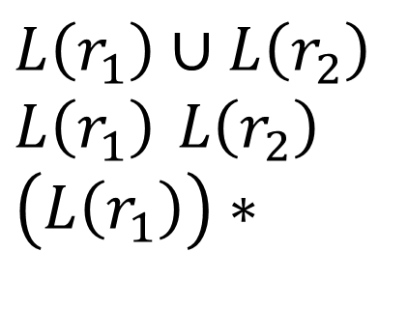
By inductive hypothesis we know:
and are regular languages
$$L(r_{1})$$
$$L(r_{2})$$
We also know:
Regular languages are closed under:
Union
$$L\left(r_{1}\right)∪L\left(r_{2}\right) \\ L\left(r_{1}\right) L\left(r_{2}\right) \\ \left(L\left(r_{1}\right)\right)∗$$
Concatenation
Star

Slide 25
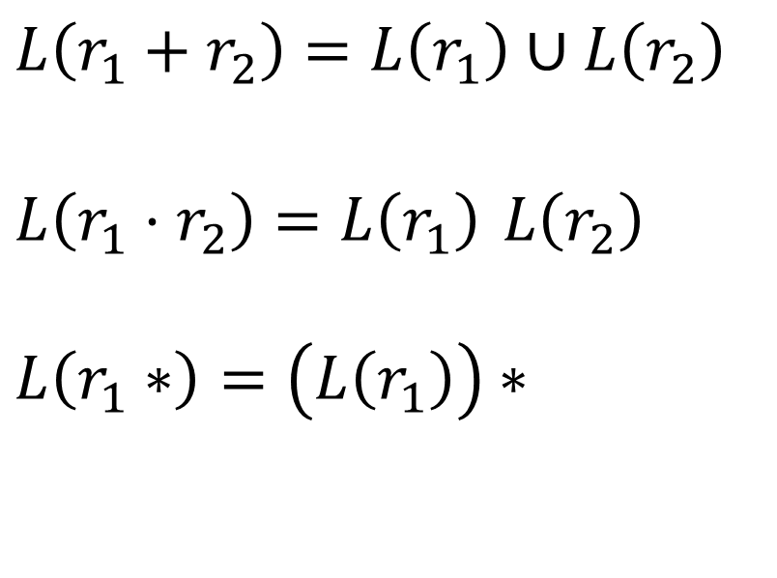
Therefore:
$$L\left(r_{1}+r_{2}\right)=L\left(r_{1}\right)∪L\left(r_{2}\right)$$ $$L\left(r_{1}⋅r_{2}\right)=L\left(r_{1}\right) L\left(r_{2}\right)$$ $$L\left(r_{1}∗\right)=\left(L\left(r_{1}\right)\right)∗$$
Are regular
languages
Thus,
Every Language Generated by a Regular Expression
is a Regular Language. (End of Proof-Part 1)

Slide 26

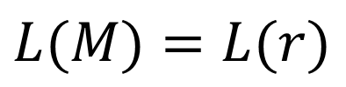
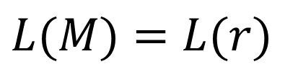





Note: Using the regular closure of operations,
we can construct recursively the NFA
that accepts
$$M$$
$$L(M)=L(r)$$
Example:
$$r=r_{1}+r_{2}$$
$$L(M)=L(r)$$
$$L(M_{1})=L(r_{1})$$
$$λ$$
$$L(M_{2})=L(r_{2})$$
$$λ$$

Slide 27




Proof - Part 2
Languages
Generated by
Regular Expressions
Regular
Languages
$$⊇$$
For any regular language there is
a regular expression with
$$L$$
$$L(r)=L$$
$$r$$
We will convert an NFA that accepts
to a regular expression
$$L$$

Slide 28



Since is regular, there is a
NFA that accepts it
$$L$$
$$M$$
$$L(M)=L$$
Take it with a single accept state

Slide 29






From construct the equivalent
Generalized Transition Graph
in which transition labels are regular expressions
$$M$$
Example:
Corresponding
Generalized transition graph
$$M$$
$$a$$
$$c$$
$$a$$
$$c$$
$$a,b$$
$$a+b$$

Slide 30










$$b$$
$$b$$
Another Example:
$$a$$
$$q_{0}$$
$$q_{1}$$
$$a,b$$
$$q_{2}$$
$$b$$
Transition labels
are regular
expressions
$$b$$
$$b$$
$$a$$
$$q_{0}$$
$$q_{1}$$
$$a+b$$
$$q_{2}$$
$$b$$

Slide 31










$$b$$
$$b$$
Reducing the states:
$$a$$
$$q_{0}$$
$$q_{1}$$
$$a+b$$
$$q_{2}$$
$$b$$
Transition labels
are regular
expressions
$$bb∗a$$
$$b$$
$$bb∗(a+b)$$
$$q_{0}$$
$$q_{2}$$

Slide 32


Resulting Regular Expression:
$$bb∗a$$
$$b$$
$$bb∗(a+b)$$
$$q_{0}$$
$$q_{2}$$
$$r=(bb∗a)∗⋅bb∗(a+b)⋅b∗$$
$$L(r)=L(M)=L$$

Slide 33











In General
Removing a state:
$$e$$
$$d$$
$$c$$
$$q_{i}$$
$$q_{j}$$
$$q$$
$$a$$
$$b$$
$$ae∗d$$
$$ce∗b$$
$$ce∗d$$
$$q_{i}$$
$$q_{j}$$
$$ae∗b$$

Slide 34








By repeating the process until
two states are left, the resulting graph is
Initial graph
Resulting graph
$$r_{1}$$
$$r_{4}$$
$$r_{3}$$
$$q_{0}$$
$$q_{f}$$
$$r_{2}$$
The resulting regular expression:
$$r=r_{1}∗r_{2}(r_{4}+r_{3}r_{1}∗r_{2})∗$$
$$L(r)=L(M)=L$$
End of Proof-Part 2

Slide 35
Summary: Standard Representations of Regular Languages
Regular Languages
DFAs
Regular
Expressions
NFAs

Slide 36
Questions?
Thank You!

